Slide 1
4.7 Brownian Bridge
報告者: 劉彥君

Slide 2
4.7.1 Gaussian Process
Definition 4.7.1:
A Gaussian process X(t), t ≥ 0, is a stochastic process that has the property that, for arbitrary times 0 < t₁ < t₂ < … < t_{n}, the random variables X(t₁), X(t₂), …, X(t_{n}) are jointly normally distributed.

Slide 3
The joint normal distribution of a set of vectors is determined by their means and covariances.
For a Gaussian process, the joint distribution of X(t₁), X(t₂), …, X(t_{n}) is determined by the means and covariances of these random variables.
We denote the mean of X(t) by m(t), and, for
s ≥ 0, t ≥ 0, we denote the covariance of X(s) and X(t) by c(s, t); i.e.,

Slide 4
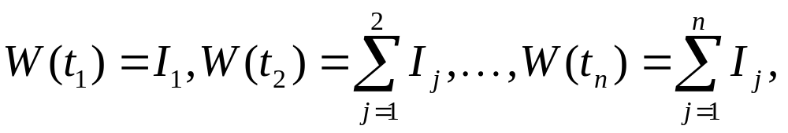
Example 4.7.2 (Brownian motion)
Brownian motion W(t) is a Gaussian process. For 0 < t₁< t₂ <…< t_{n}, the increments
are independent and normally distributed. Writing

Slide 5
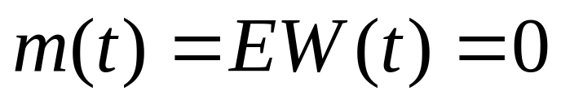
Example 4.7.2 (Brownian motion)
The random variables W(t₁), W(t₂), …, W(t_{n}) are jointly normally distributed.
These random variables are not independent.
the increments of Brownian motion that are independent.
The mean function for Brownian motion is

Slide 6
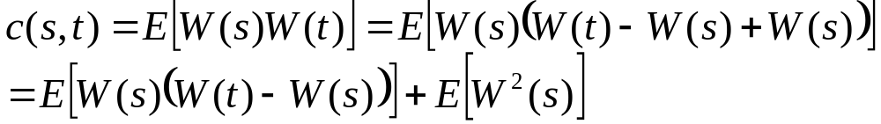

Example 4.7.2 (Brownian motion)
We may compute the covariance by letting 0 ≤ s ≤ t be given and noting that
Because W(s) and W(t) - W(s) are independent and both have mean zero, we see that
The other term, E[W ²(s)], is the variance of W(s), which is s.

Slide 7
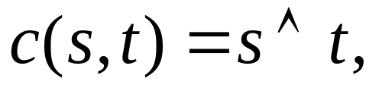

Example 4.7.2 (Brownian motion)
We conclude that c(s,t)=s when 0 ≤ s ≤ t.
Reversing the roles of s and t, we conclude that c(s,t)=t when 0 ≤ t ≤ s.
In general, the covariance function for Brownian motion is then
where denotes the minimum of s and t.

Slide 8
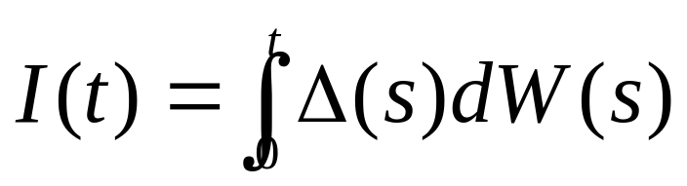
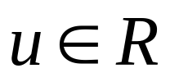
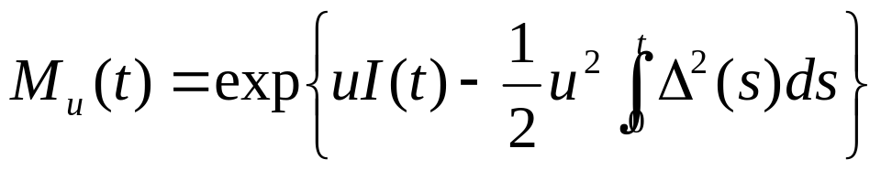
Example 4.7.3
(Itô integral of a deterministic integrand)
Let ∆(t) be a nonrandom function of time, and define
where W(t) is a Brownian motion. Then I(t) is a Gaussian process, as we now show.
In the proof of Theorem 4.4.9, we showed that, for fixed , the process
is a martingale.

Slide 9
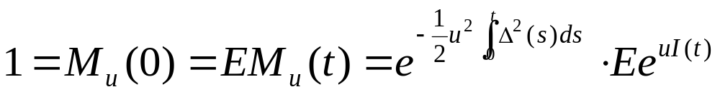
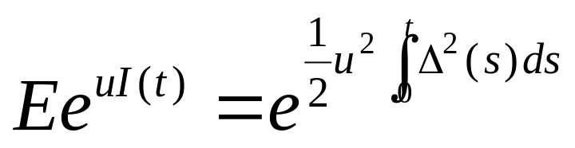
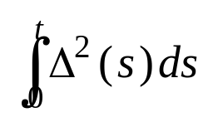
Example 4.7.3
(Itô integral of a deterministic integrand)
Then
and we thus obtained the moment-generating function formula
(with mean zero and variance )
Therefore, this is the distribution of I(t).

Slide 10
Example 4.7.3
(Itô integral of a deterministic integrand)
We have shown that I(t) is normally distributed, verification that the process is Gaussian requires more.
Verify that, for 0 < t₁ < t₂ < … < t_{n}, the random variables I(t₁), I(t₂), …, I(t_{n}) are jointly normally distributed.

Slide 11
Example 4.7.3
(Itô integral of a deterministic integrand)
It turns out that the increments
are normally distributed and independent, and from this the joint normality of I(t₁), I(t₂), … ,I(t_{n}) follows by the same argument as used in Example 4.7.2 for Brownian motion.
Next, we show that, for 0 < t₁ < t₂, the two random increments I(t₁)-I(0)=I(t₁) and I(t₂)-I(t₁) are normally distributed and independent.
The argument we provide can be iterated to prove this result for any number of increments.

Slide 12
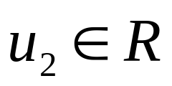
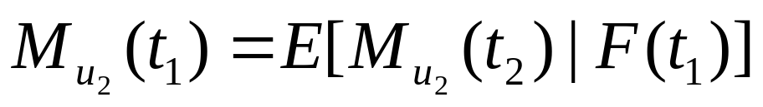
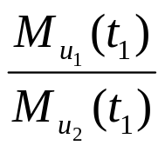
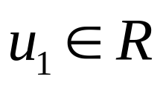
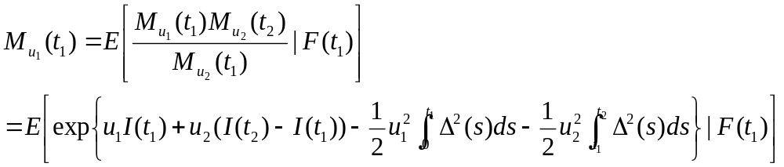
Example 4.7.3
(Itô integral of a deterministic integrand)
For fixed , the martingale property of M_{u2} implies that
Now let be fixed. Because if F(t1)-measurable, we may multiply the equation above by this quotient to obtain

Slide 13
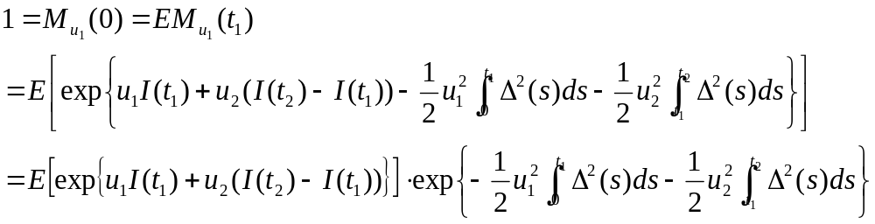
Example 4.7.3
(Itô integral of a deterministic integrand)
We now take expectations
Where we have used the fact that ∆²(s) is nonrandom to take the integrals of ∆²(s) outside the expectation on the right-hand side.

Slide 14
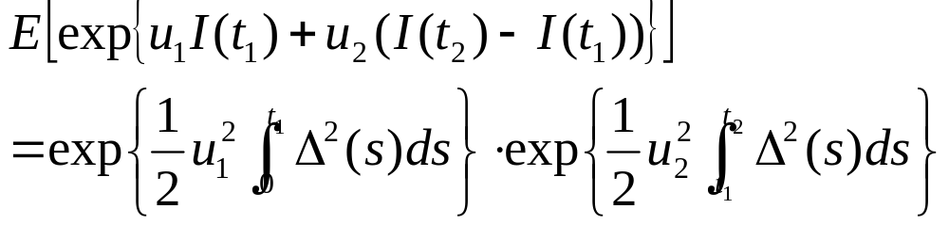
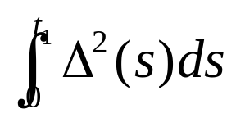
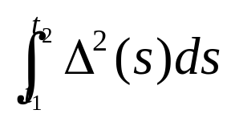
Example 4.7.3
(Itô integral of a deterministic integrand)
This leads to the moment-generating function formula
The right hand side is the product of
  the moment-generating function for a normal random variable with mean zero and variance
  the moment-generating function for a normal random variable with mean zero and variance

Slide 15
Example 4.7.3
(Itô integral of a deterministic integrand)
It follows that I(t₁) and I(t₂)-I(t₁) must have these distributions, and because their joint moment-generating function factors into this product of moment-generating functions, they must be independent.
The covariance of I(t₁) and I(t₂) can be computed using the same trick as in Example 4.7.2 for the covariance of Brownian motion.

Slide 16
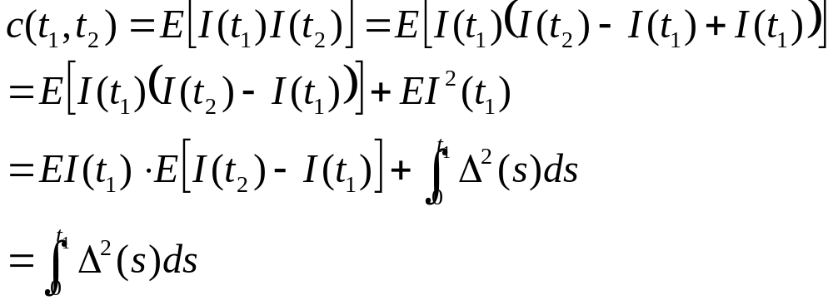
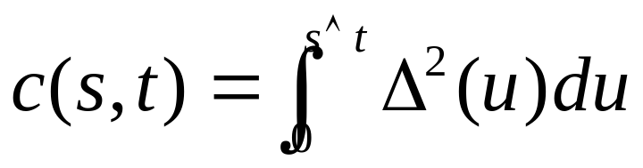
Example 4.7.3
(Itô integral of a deterministic integrand)
We have
For the general case where s ≥ 0 and t ≥ 0 and we do not know the relationship between s and t, we have the covariance formula
By Thm
4.2.2

Slide 17
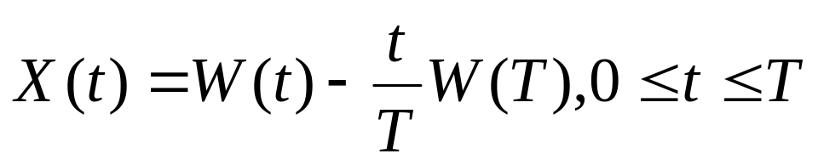
4.7.2 Brownian Bridge as a Gaussian Process
Definition 4.7.4.
Let W(t) be a Brownian motion. Fix T>0. We define the Brownian bridge from 0 to 0 on
[0,T] to be the process
(4.7.2)

Slide 18
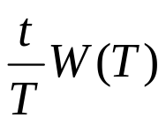
4.7.2 Brownian Bridge as a Gaussian Process
Note that as a function of t is the line from (0, 0) to (T, W(T)).
In (4.7.2), we have subtracted this line away from the Brownian motion W(t), so that the resulting process X(t) satisfies
X(0) = X(T) = 0
Because W(T) enters the definition of X(t) for 0 ≤ t ≤ T, the Brownian bridge X(t) is not adapted to the filtration F(t) generated by W(t).

Slide 19
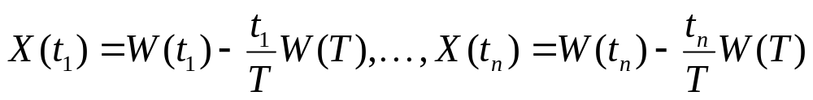
4.7.2 Brownian Bridge as a Gaussian Process
For 0 < t₁ < t₂ < … < t_{n} < T, the random variables
are jointly normal because W(t₁),…, W(t_{n}), W(T) are jointly normal.
Hence, the Brownian bridge from 0 to 0 is a Gaussian process.

Slide 20
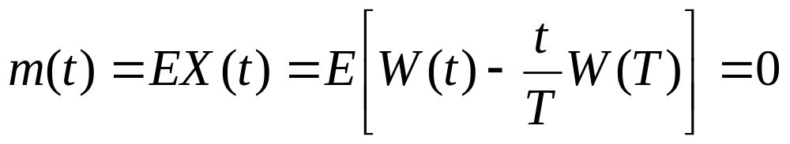
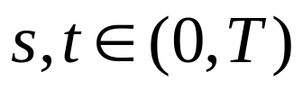
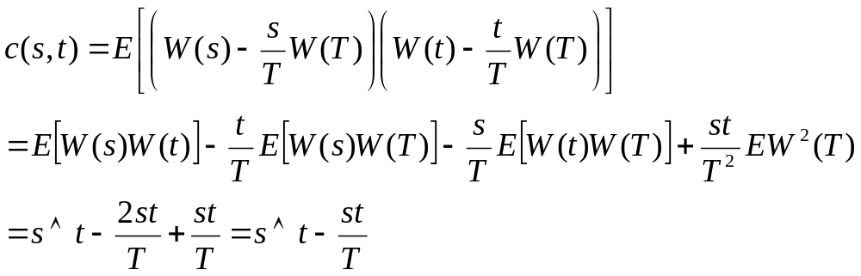
4.7.2 Brownian Bridge as a Gaussian Process
Its mean function is easily seen to be
For ,we compute the covariance function

Slide 21


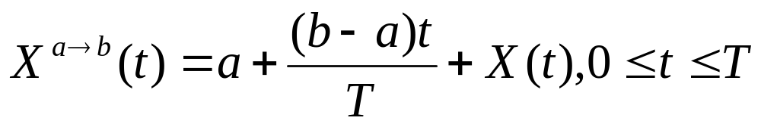
4.7.2 Brownian Bridge as a Gaussian Process
Definition 4.7.5.
Let W(t) be a Brownian motion. Fix T>0,
and . We define the Brownian bridge from a to b on [0, T] to be the process
where X(t) = X^{0→0} is the Brownian bridge from 0 to 0 of Definition 4.7.4.

Slide 22
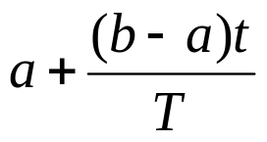
4.7.2 Brownian Bridge as a Gaussian Process
The function , as a function of t, is the line from (0, a) to (T, b).
When we add this line to the Brownian bridge from 0 to 0 on [0, T], we obtain a process that begins at a at time 0 and ends at b at time T.
Adding a nonrandom function to a Gaussian process gives us another Gaussian process.

Slide 23
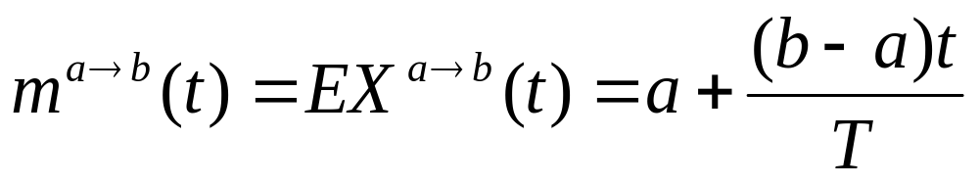
4.7.2 Brownian Bridge as a Gaussian Process
The mean function is affected:
However, the covariance function is not affected:

Slide 24
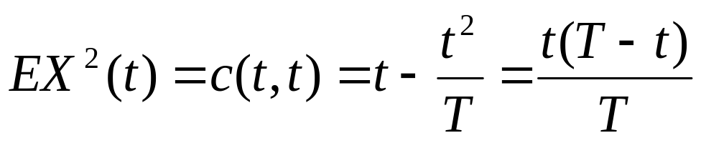
4.7.3 Brownian Bridge as a Scaled Stochastic Integral
We cannot write the Brownian bridge as a stochastic integral of a deterministic integrand because the variance of the Brownian bridge,
increases for 0 ≤ t ≤ T/2 and then decreases for T/2 ≤ t ≤ T.

Slide 25
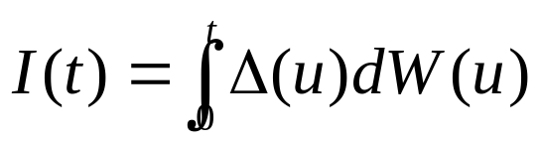
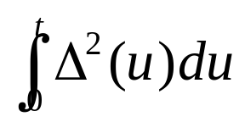
4.7.3 Brownian Bridge as a Scaled Stochastic Integral
In Example 4.7.3, the variance of
is , which is nondecreasing in t.
We can obtain a process with the same distribution as the Brownian bridge from 0 to 0 as a scaled stochastic integral.

Slide 26
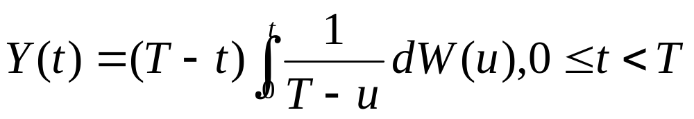
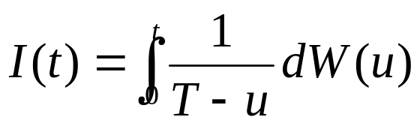
4.7.3 Brownian Bridge as a Scaled Stochastic Integral
Consider
The integral
is a Gaussian process of the type discussed in Example 4.7.3, provided t < T so the integrand is defined.

Slide 27
4.7.3 Brownian Bridge as a Scaled Stochastic Integral
For 0 < t₁ < t₂ < … < t_{n} < T, the random variables
Y(t₁) = (T - t₁)I(t₁), Y(t₂) = (T - t₂)I(t₂),…,Y(t_{n}) = (T - t_{n})I(t_{n})
are jointly normal because I(t₁), I(t₂),…,I(t_{n}) are jointly normal.
In particular, Y is a Gaussian process.

Slide 28
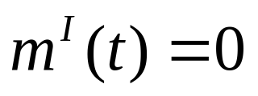
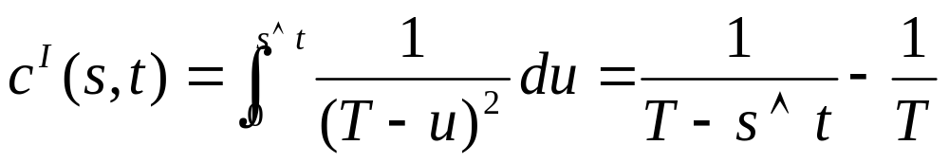
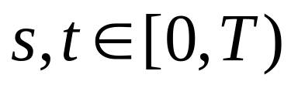
4.7.3 Brownian Bridge as a Scaled Stochastic Integral
The mean and covariance functions of I are
for all
This means that the mean function for Y is m^{Y}(t) = 0

Slide 29
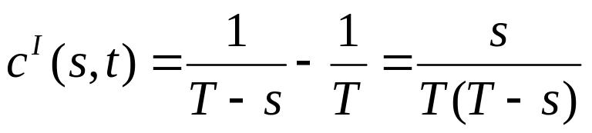
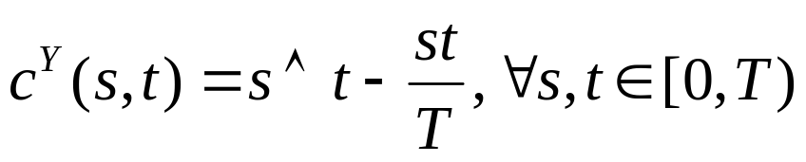
4.7.3 Brownian Bridge as a Scaled Stochastic Integral
To compute the covariance function for Y, we assume for the moment that 0 ≤ s ≤ t ≤ T so that
Then
If we had taken 0 ≤ t ≤ s < T, the roles of s and t would have bee reversed. In general

Slide 30
4.7.3 Brownian Bridge as a Scaled Stochastic Integral
This is the same covariance formula (4.7.3) we obtained for the Brownian bridge.
Because the mean and covariance functions for Gaussian process completely determine the distribution of the process, we conclude that the process Y has the same distribution as the Brownian bridge from 0 to 0 on [0,T].

Slide 31
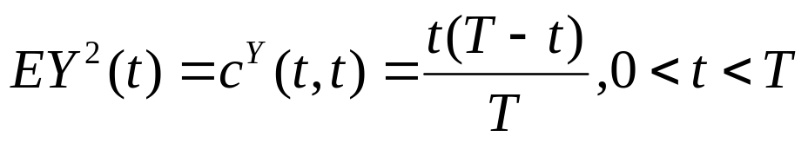
4.7.3 Brownian Bridge as a Scaled Stochastic Integral
We now consider the variance
Note that, as t↑T, this variance converges to 0.
  As t↑T => the random process Y(t), has mean=0
  => variance converges to 0.
We did not initially define Y(t), but this observation suggests that it makes sense to define Y(T)=0.
If we do that, then Y(t) is continuous at t=T.

Slide 32
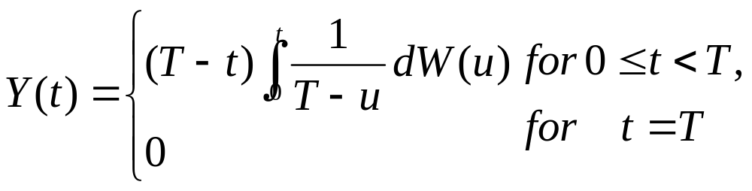
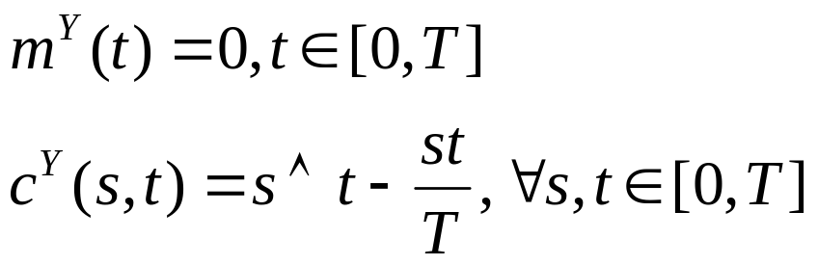
4.7.3 Brownian Bridge as a Scaled Stochastic Integral
Theorem 4.7.6
Define the process
Then Y(t) is a continuous Gaussian process on [0,T] and has mean and covariance functions
In particular, the process Y(t) has the same distribution as the Brownian bridge from 0 to 0 on [0,T] (Definition 4.7.5)

Slide 33
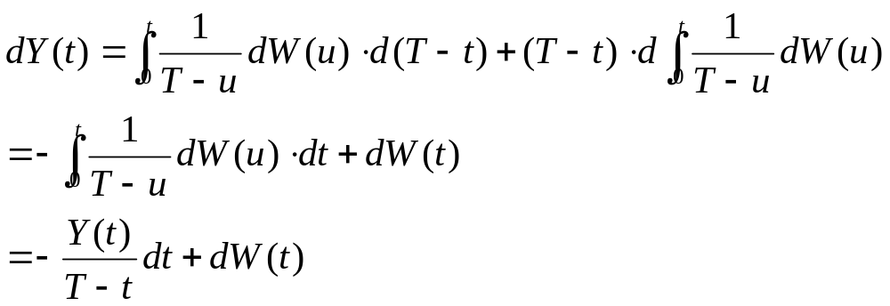
4.7.3 Brownian Bridge as a Scaled Stochastic Integral
We note that the process Y(t) is adapted to the filtration generated by the Brownian motion W(t).
Compute the stochastic differential of Y(t), which is

Slide 34
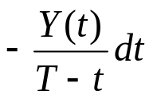
4.7.3 Brownian Bridge as a Scaled Stochastic Integral
If Y(t) is positive as t approaches T, the drift term becomes large in absolute value and is negative.
  This drives Y(t) toward zero.
On the other hand, if Y(t) is negative, the drift term becomes large and positive, and this again drives Y(t) toward zero.
This strongly suggests, and it is indeed true, that as t↑T the process Y(t) converges to zero almost surely.

